Slide 1

INTRODUCTION TO DATA ANALYTICS
DONE BY
ANGELINE.J
2021-7234

Slide 2
WHAT IS DATA ANALYTICS: Data has been the buzzword for ages now. Either the data being generated from large-scale enterprises or the data generated from an individual, each and every aspect of data needs to be analyzed to benefit yourself from it. But how do we do it? Well, that’s where the term ‘Data Analytics’ comes in.

Slide 3
Why is Data Analytics important?
Data Analytics has a key role in improving your business as it is used to gather hidden insights, generate reports, perform market analysis, and improve business requirements.

Slide 4
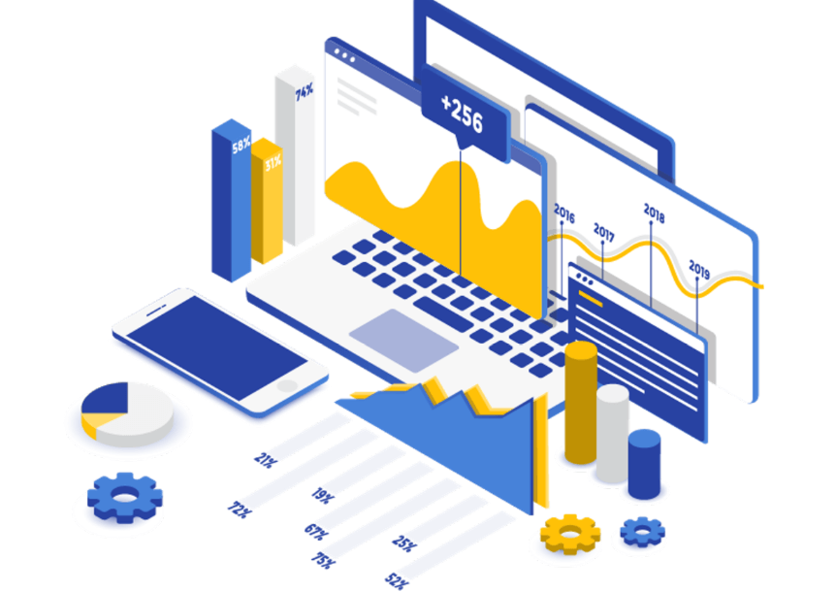

Slide 5
What is the role of Data Analytics?
You can refer below:
Gather Hidden Insights – Hidden insights from data are gathered and then analyzed with respect to business requirements.
Generate Reports – Reports are generated from the data and are passed on to the respective teams and individuals to deal with further actions for a high rise in business.
Perform Market Analysis – Market Analysis can be performed to understand the strengths and weaknesses of competitors.
Improve Business Requirement – Analysis of Data allows improving Business to customer requirements and experience.

Slide 6
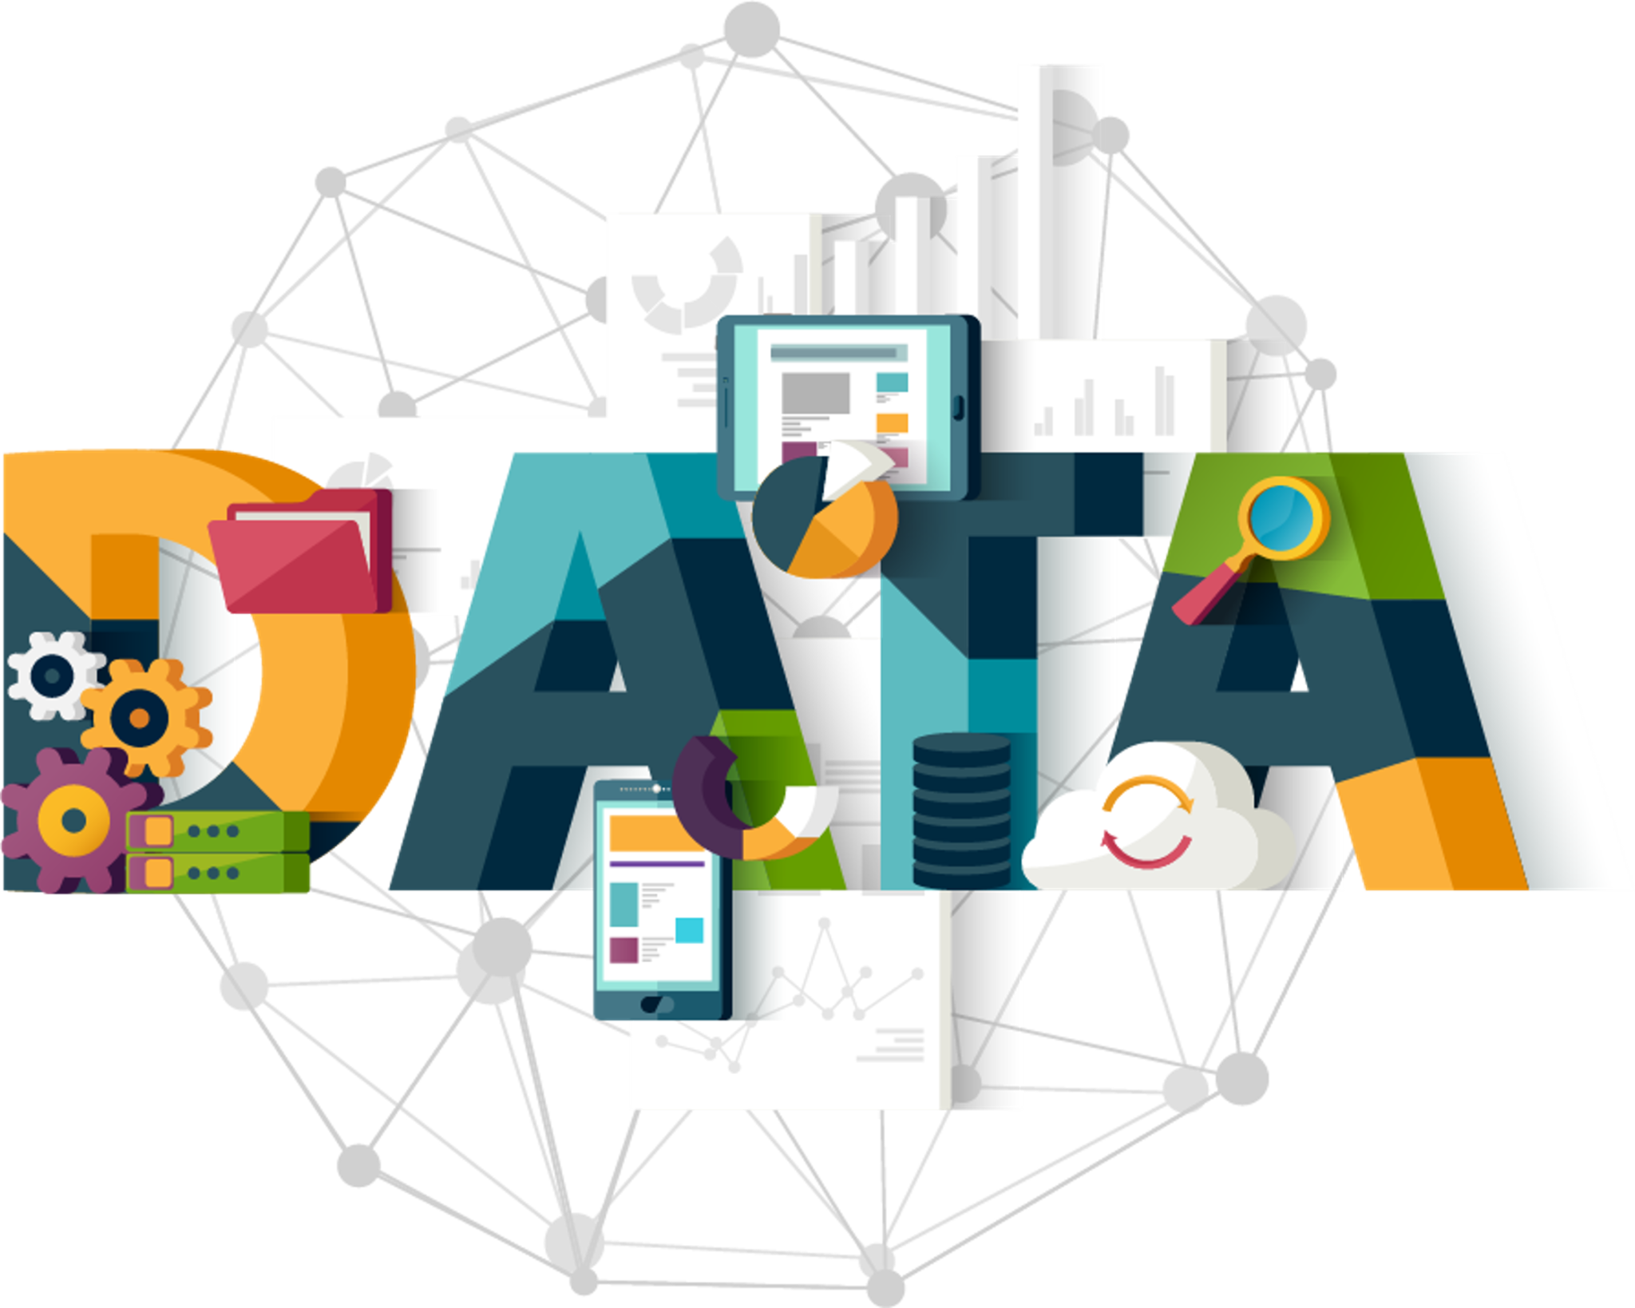
What is Data Analytics for Beginners?
Data Analytics refers to the techniques used to analyze data to enhance productivity and business gain. Data is extracted from various sources and is cleaned and categorized to analyze various behavioral patterns. The techniques and the tools used vary according to the organization or individual.
So, in short, if we understand our Business Administration and have the capability to perform Exploratory Data Analysis, to gather the required information, then we are good to go with a career in Data Analytics.

Slide 7
Tools used in Data Analytics
R programming – This tool is the leading analytics tool used for statistics and data modeling. R compiles and runs on various platforms such as UNIX, Windows, and Mac OS. It also provides tools to automatically install all packages as per user-requirement.
Python – Python is an open-source, object-oriented programming language that is easy to read, write, and maintain. It provides various machine learning and visualization libraries such Tableau Public – This is a free software that connects to any data source such as Excel, corporate Data Warehouse, etc. It then creates visualizations, maps, dashboards etc with real-time updates on the web.
QlikView – This tool offers in-memory data processing with the results delivered to the end-users quickly. It also offers data association and data visualization with data being compressed to almost 10% of its original size.
SAS – A programming language and environment for data manipulation and analytics, this tool is easily accessible and can analyze data from different sources.
Microsoft Excel – This tool is one of the most widely used tools for data analytics. Mostly used for clients’ internal data, this tool analyzes the tasks that summarize the data with a preview of pivot tables.

Slide 8
RapidMiner – A powerful, integrated platform that can integrate with any data source types such as Access, Excel, Microsoft SQL, Tera data, Oracle, Sybase etc. This tool is mostly used for predictive analytics, such as data mining, text analytics, machine learning.
KNIME – Konstanz Information Miner (KNIME) is an open-source data analytics platform, which allows you to analyze and model data. With the benefit of visual programming, KNIME provides a platform for reporting and integration through its modular data pipeline concept.
OpenRefine – Also known as GoogleRefine, this data cleaning software will help you clean up data for analysis. It is used for cleaning messy data, the transformation of data and parsing data from websites.
Apache Spark – One of the largest large-scale data processing engine, this tool executes applications in Hadoop clusters 100 times faster in memory and 10 times faster on disk. This tool is also popular for data pipelines and machine learning model development.

Slide 9
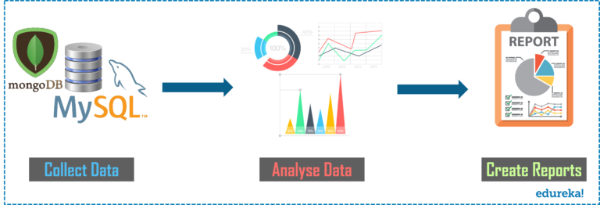
Process of Data Analytics::

Slide 10
THANK YOU

